Slide 1
Analysis of Algorithms
CSCI 2010U - Data Structures

Slide 2
Outline
Counting primitive operations
Analysis
Growth rate
7 important functions
Big-oh notation
Object-Oriented Programming
2

Slide 3
Counting Primitive Operations
Counting primitive operations:
With algorithm analysis, we want a formula that describes how many primitive operations our algorithm will perform
Primitive operations including anything that takes a constant amount of time to execute
Some example primitive operations:
Assigning a value to a variable
Any arithmetic (or other) operator (e.g. +, -, *, /, &&, ||)
Array indexing, dereferencing a pointer
Calling a function, returning from a function (but not the code of the function itself, necessarily)
etc.
Object-Oriented Programming
3
Notes:
The following operations are not primitive: loops, execution of a function (including recursion)

Slide 4
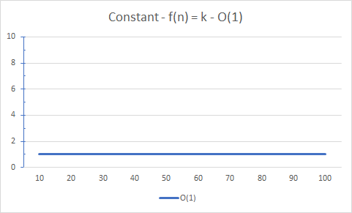
7 Important Functions
Analysis of Algorithms
4

Slide 5
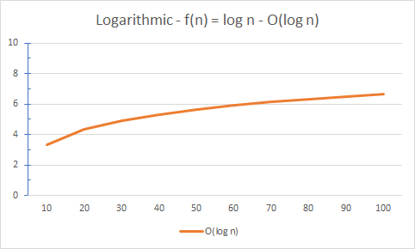
7 Important Functions
Analysis of Algorithms
5

Slide 6
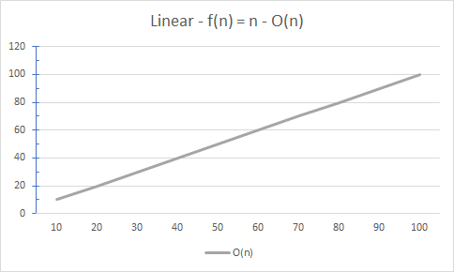
7 Important Functions
Analysis of Algorithms
6

Slide 7
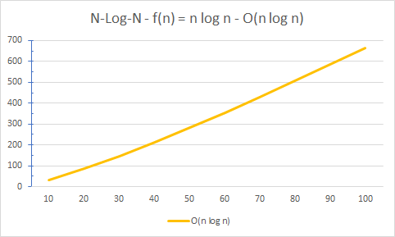
7 Important Functions
Analysis of Algorithms
7

Slide 8
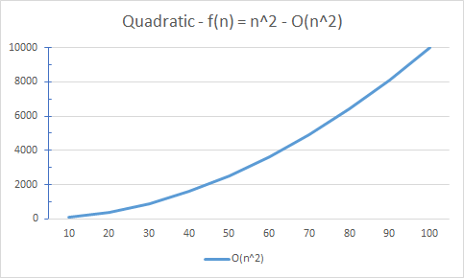
7 Important Functions
Analysis of Algorithms
8

Slide 9
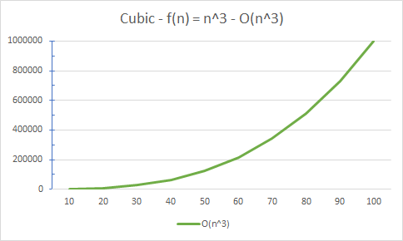
7 Important Functions
Analysis of Algorithms
9

Slide 10
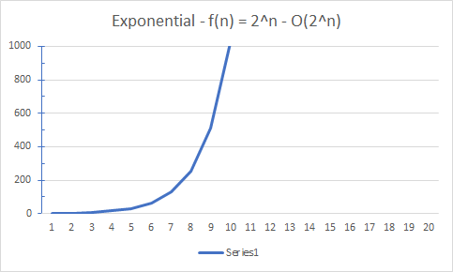
7 Important Functions
Analysis of Algorithms
10

Slide 11
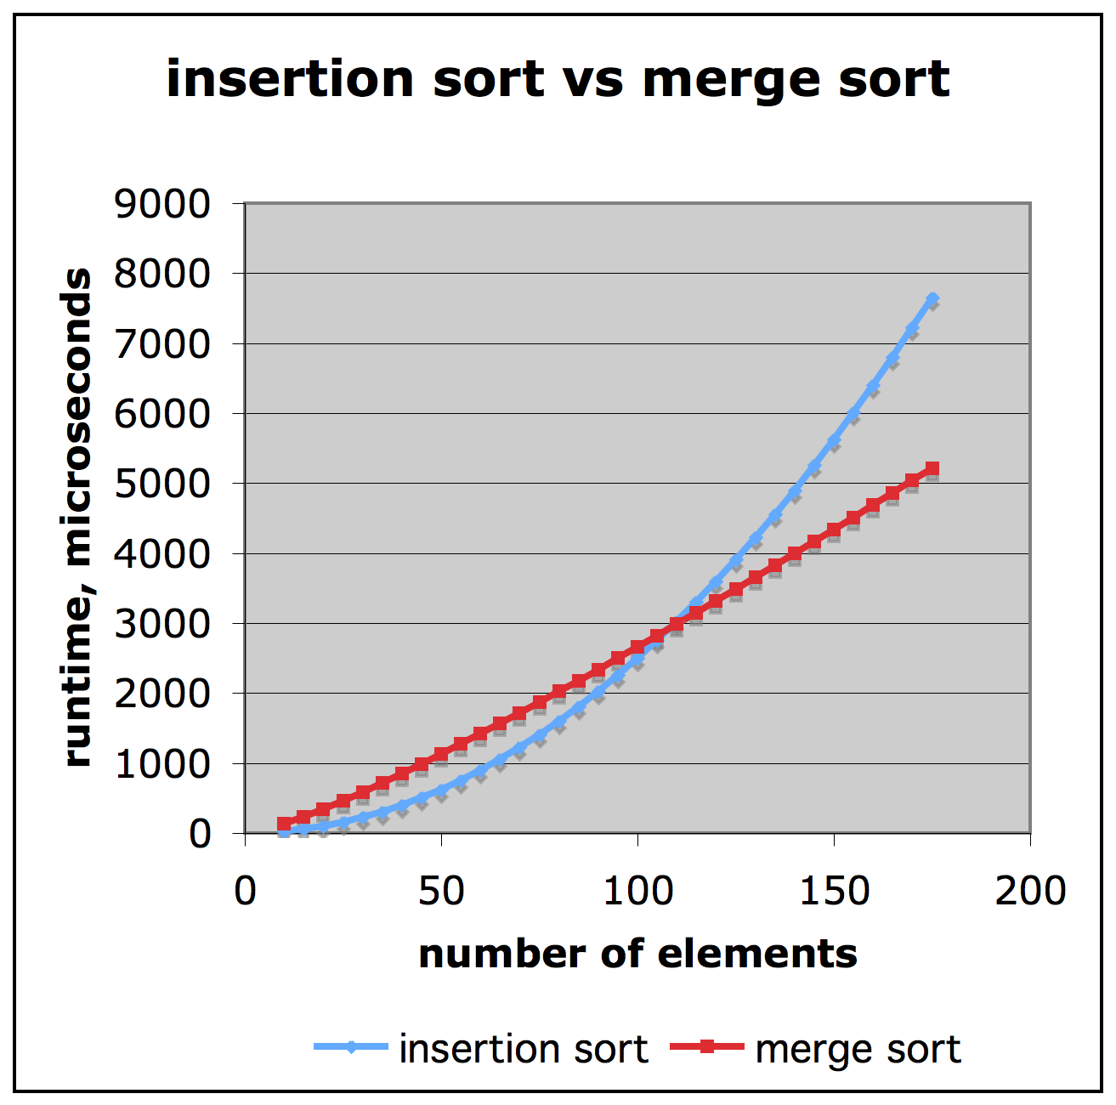
Comparison of Two Algorithms
insertion sort is
n² / 4
merge sort is
2 n lg n
sort a million items?
insertion sort takes
roughly 70 hours
while
merge sort takes
roughly 40 seconds
Analysis of Algorithms
11

Slide 12
Big-Oh
Big O describes an upper bound on the time
Big O just describes the rate of increase.
For this reason, we drop the constants in runtime.
An algorithm that one might have described as 0(2N) is actually O(N).
Big O helps in answering “How does the runtime of a program grows with increasing input?”
Analysis of Algorithms
12

Slide 13
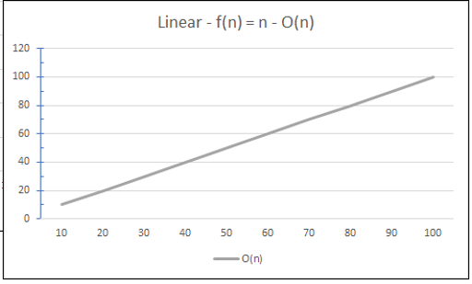

Big-Oh
Linear Complexity is when runtime increases with the size
We only consider the fastest growing term which is ‘n’ in this case
Drop any constants with the fastest growing term
$$T=an+b$$
Analysis of Algorithms
13

Slide 14
Big-Oh Examples
7n - 2
7n - 2 is O(n)
3n³ + 20n² + 5
3n³ + 20n² + 5 is O(n³)
3 log n + 5
3 log n + 5 is O(log n)
Analysis of Algorithms
14
Notes:
Let's try a few examples.

Slide 15
Constant Time O(1)
package Big_O;
public class Driver {
public static int constant_function(int arr[])
{
int number = 0; // O(1)
return number; // O(1)
// total time = O(1) + O(1) = O(2) which is constant
}
public static void main(String[] args) {
int arr[] = new int[5];
constant_function(arr);
}
}
Analysis of Algorithms
15
Notes:
Let's try a few examples.

Slide 16
Linear Time O(n)
public static int linear_function(int arr[])
{
int sum = 0; // O(1)
for (int i=0; i<arr.length; i++) // this runs n times
{
sum+=i; // O(1)
}
return sum; // O(1)
// total time = O(1) + n x O(1) + O(1) = O(n)
}
Analysis of Algorithms
16
Notes:
Let's try a few examples.

Slide 17
Linear Time O(n)
public static void sum_product(int arr[])
{
int sum = 0; // O(1)
for (int i=0; i<arr.length; i++) // this runs n times
{
sum+=i; // O(1)
}
System.out.println("Sum: " + sum); // O(1)
int product = 0; // O(1)
for (int i=0; i<arr.length; i++) // this runs n times
{
product*=i; // O(1)
}
System.out.println("Product: " + product); // O(1)
// total time = O(1) + n x O(1) + O(1) + O(1) + n x O(1) + O(1) = O(2n) = O(n)
}
Analysis of Algorithms
17
Notes:
Let's try a few examples.

Slide 18
Quadratic Time O(n)
public static void pairs(int arr[])
{
for (int i=0; i<arr.length; i++) // this runs n times
{
for (int j=0; j<arr.length; j++) // this runs n times
{
System.out.printf("(%d,%d)", arr[i], arr[j]); // O(1)
}
}
// total time = O(n) x O(n) + O(1) = O(n^2)
}
Analysis of Algorithms
18
Notes:
Let's try a few examples.

Slide 19
O(n x m)
public static void two_arrays(int arr1[], int arr2[])
{
for (int i=0; i<arr1.length; i++) // this runs n times
{
for (int j=0; j<arr2.length; j++) // this runs m times
{
System.out.printf("(%d,%d)", arr1[i], arr2[j]); //O(1)
}
}
// total time = O(n) x O(m) x O(1) = O(n x m)
}
Analysis of Algorithms
19
Notes:
Let's try a few examples.

Slide 20
Wrap-up
Counting primitive operations
Analysis
Growth rate
7 important functions
Big-oh notation
Object-Oriented Programming
20

